Slide 1



TUSKEGEE AIRMEN GLOBAL ACADEMY
“CONTINUING A LEGACY OF EXCELLENCE”
TUSKEGEE AIRMEN GLOBAL ACADEMY
“Continuing a Legacy of Excellence”
GO Team Meeting
September 20, 2023
4:00 pm

Slide 2

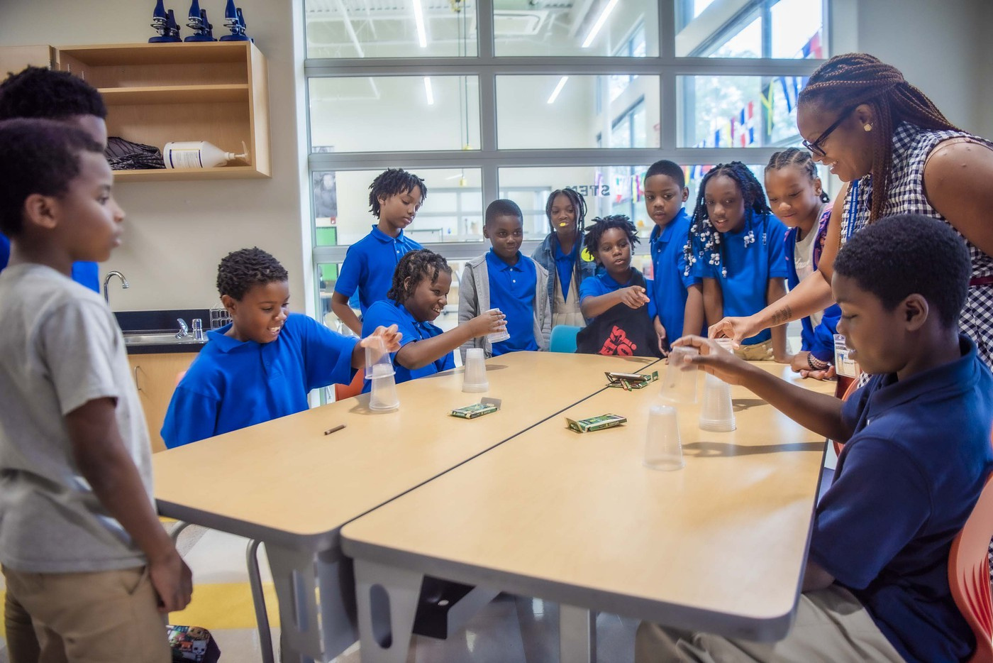
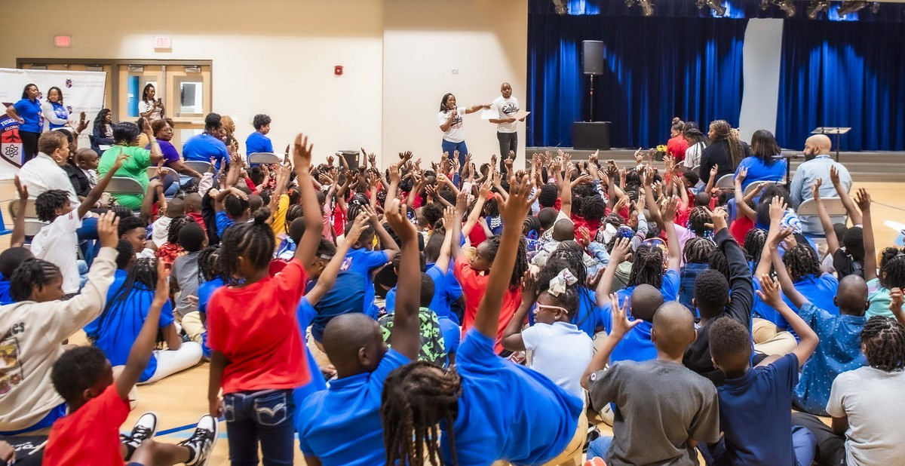
TUSKEGEE AIRMEN GLOBAL ACADEMY
“CONTINUING A LEGACY OF EXCELLENCE”
GO Team Meeting #1
Agenda Topics
  Call to Order
  Roll Call
  Action Item
    Approval of Agenda
    Previous Minutes
    Fill Vacant position
  School Strategic Plan
    School Priorities Review
    SMART Goals
  Data Discussion
    Spring MAP
    GMAS Results
  Principal’s Report
    Current Enrollment & Leveling
    Information about our school

Slide 3
TUSKEGEE AIRMEN GLOBAL ACADEMY
“CONTINUING A LEGACY OF EXCELLENCE”
Roll Call
Renina Knapp
Am’ri Jones
Alexis White
Chair
Vice- Chair
Secretary
Melanie Sithole
Janay Boyd
Jackie Thrash
Charlese Malcom
Principal
Cluster Advisory
Community Partner
Community Partner
Camri Dorsey
Sabine Alozie
Vacant
Staff Representiatove
Parent
Parent

Slide 4



TUSKEGEE AIRMEN GLOBAL ACADEMY
“CONTINUING A LEGACY OF EXCELLENCE”
Action Items:
Approval of Agenda
Nomination for Parent Seat
Chair / Team
Chair / Team
Approval of Meeting Minutes
Approval of Nominee
Chair /Team
Chair / Team

Slide 5


TUSKEGEE AIRMEN GLOBAL ACADEMY
“CONTINUING A LEGACY OF EXCELLENCE”
DISCUSSION ITEMS

Slide 6
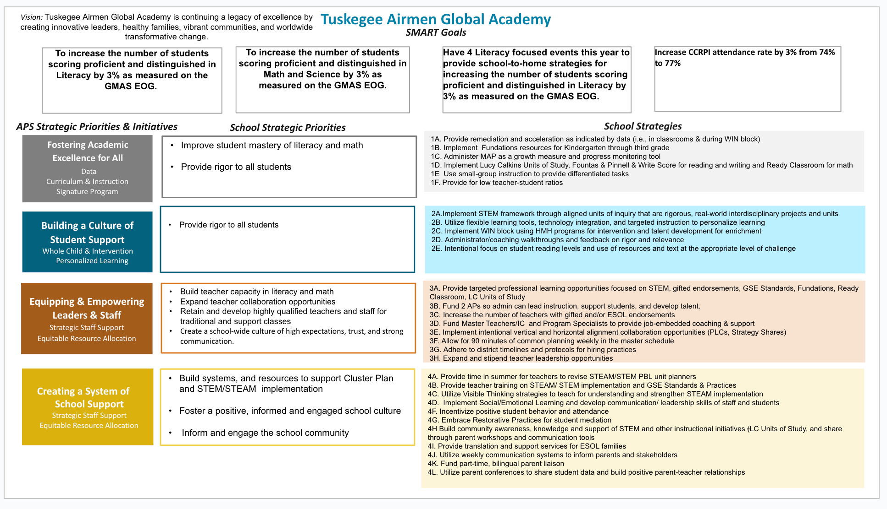

Slide 7

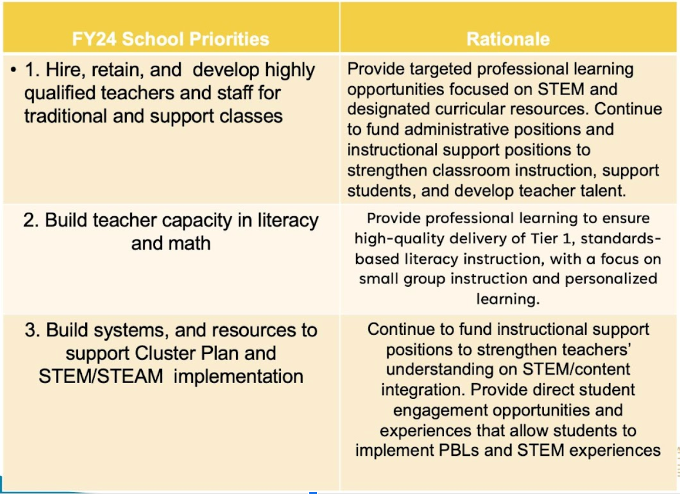
TUSKEGEE AIRMEN GLOBAL ACADEMY
“CONTINUING A LEGACY OF EXCELLENCE”
2021-2025 Strategic Plan
Priority Rank

Slide 8

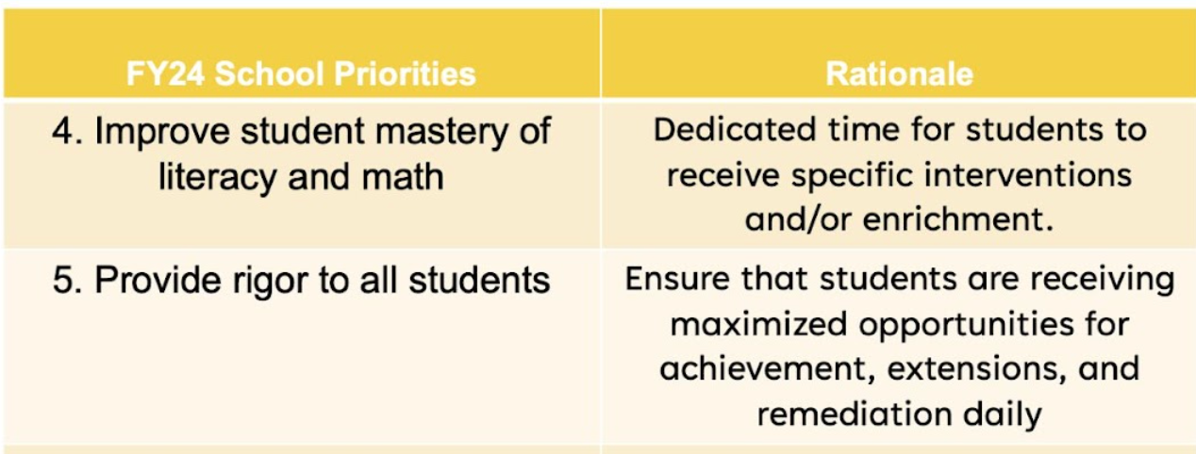
TUSKEGEE AIRMEN GLOBAL ACADEMY
“CONTINUING A LEGACY OF EXCELLENCE”
2021-2025 Strategic Plan
Priority Rank

Slide 9
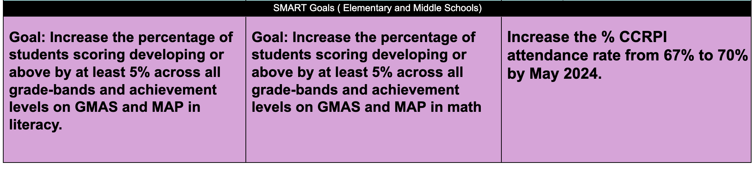
TUSKEGEE AIRMEN GLOBAL ACADEMY
“CONTINUING A LEGACY OF EXCELLENCE”
Continuous Improvement
& Strategic Plan

Slide 10
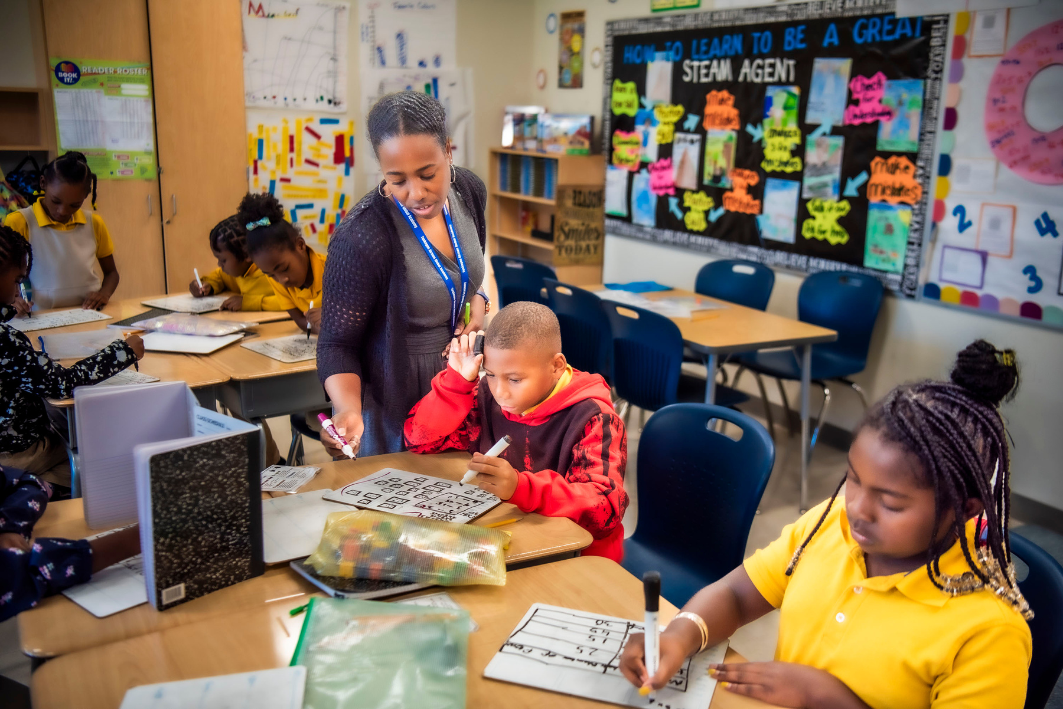

TUSKEGEE AIRMEN GLOBAL ACADEMY
“CONTINUING A LEGACY OF EXCELLENCE”
GMAS DATA

Slide 11
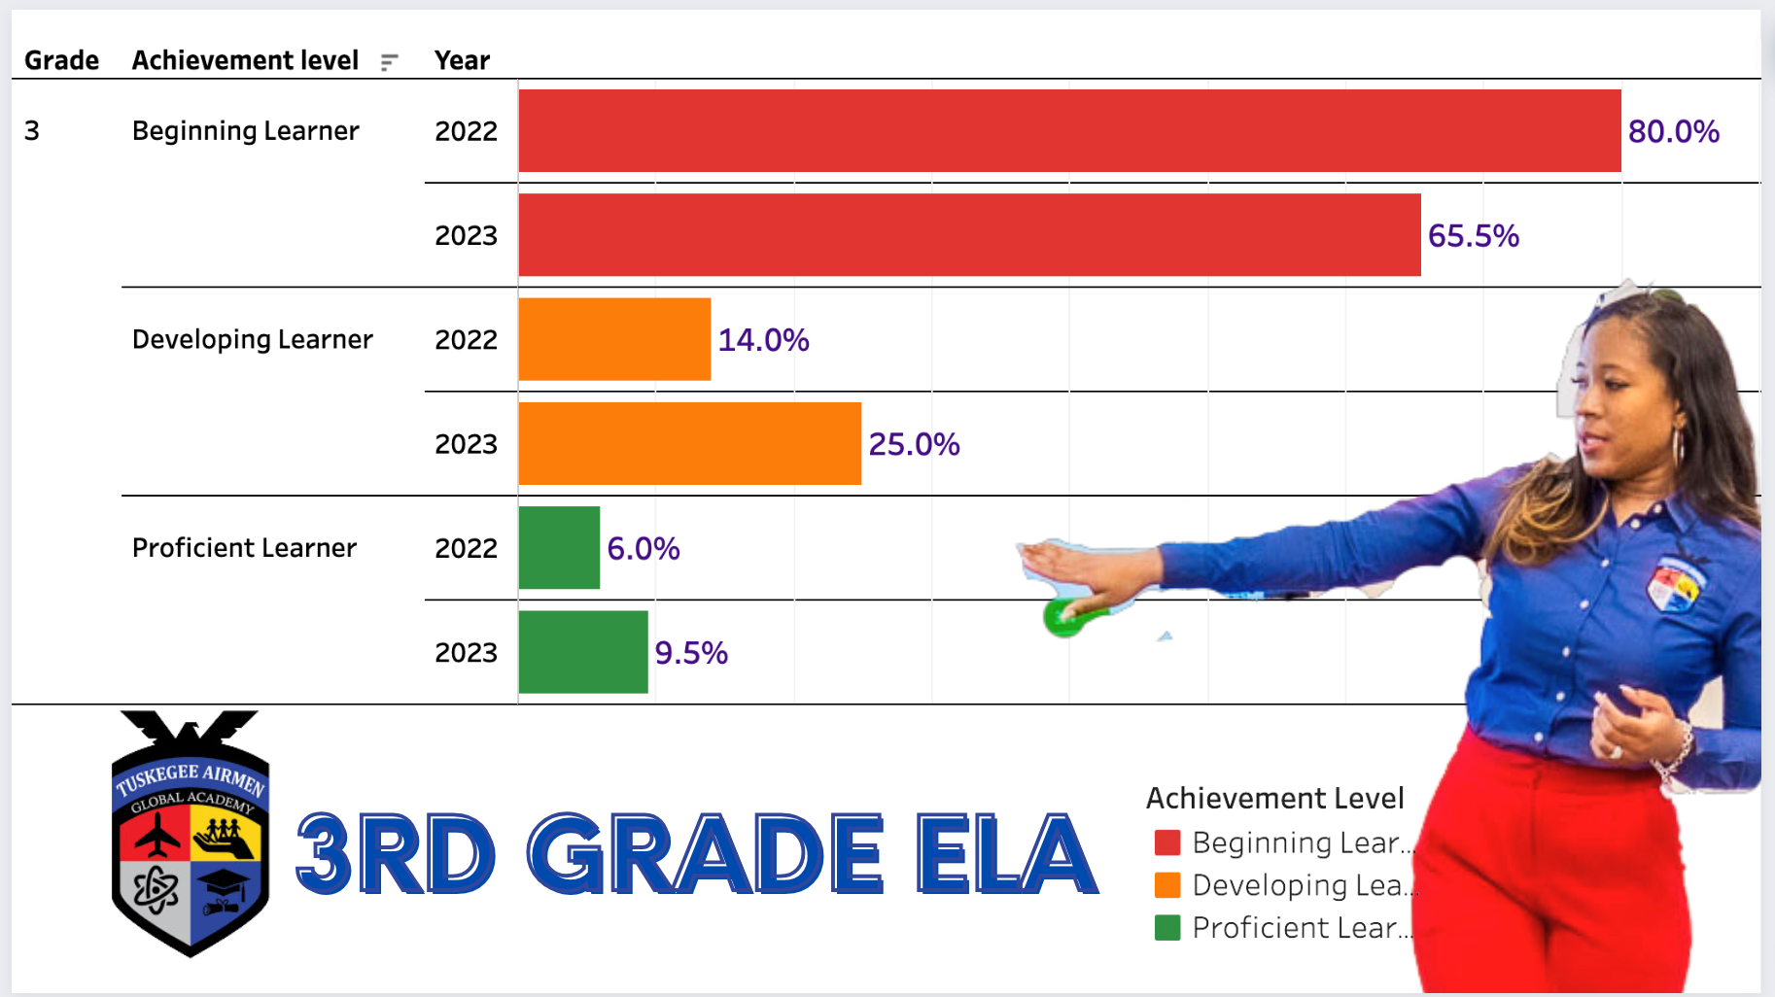
TUSKEGEE AIRMEN GLOBAL ACADEMY
“CONTINUING A LEGACY OF EXCELLENCE”
GMAS Overview

Slide 12
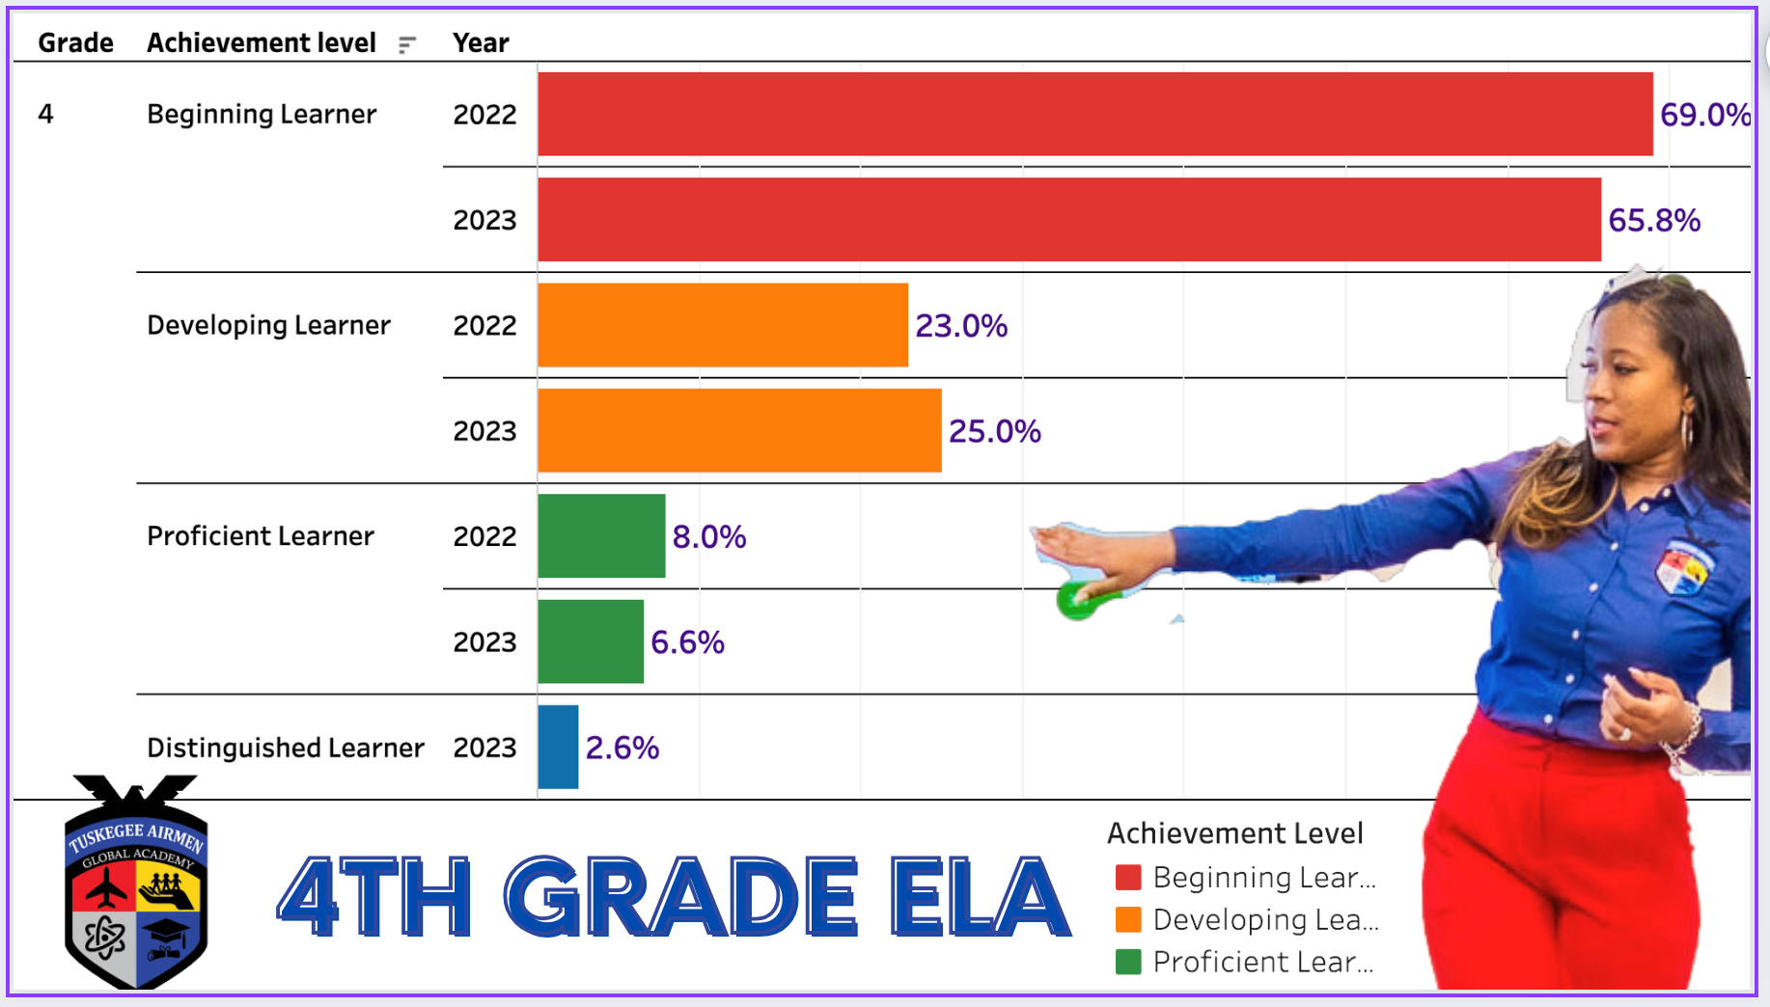
TUSKEGEE AIRMEN GLOBAL ACADEMY
“CONTINUING A LEGACY OF EXCELLENCE”
GMAS Overview

Slide 13
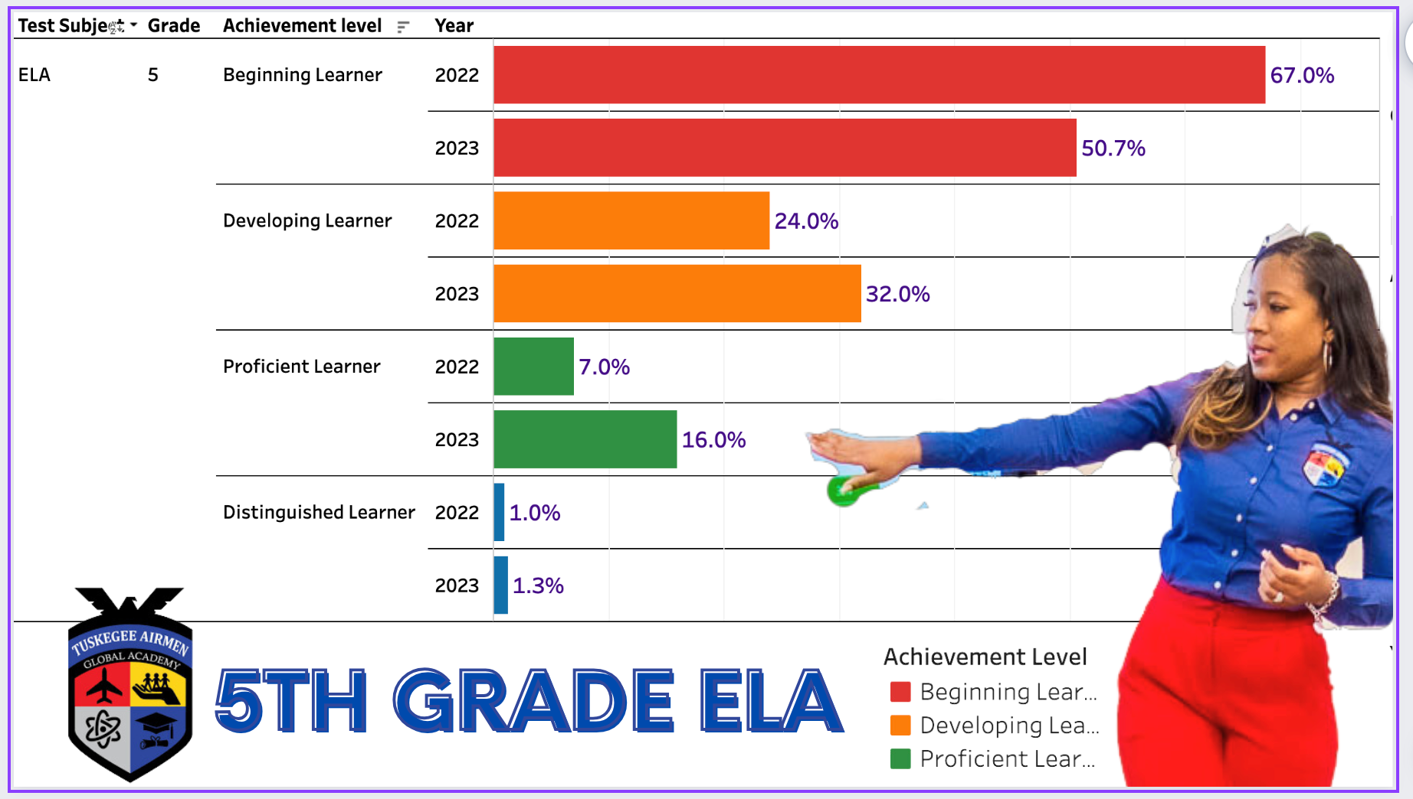
TUSKEGEE AIRMEN GLOBAL ACADEMY
“CONTINUING A LEGACY OF EXCELLENCE”
GMAS Overview

Slide 14
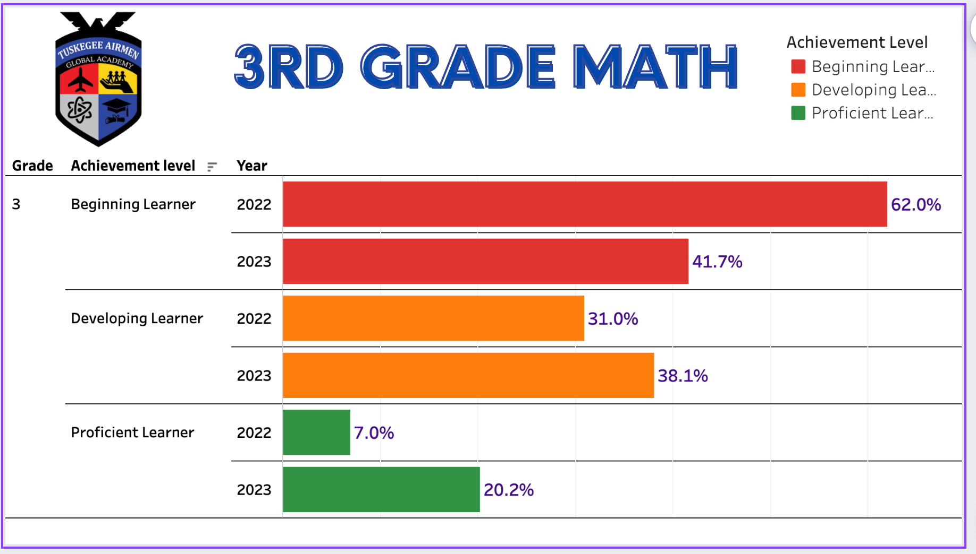
TUSKEGEE AIRMEN GLOBAL ACADEMY
“CONTINUING A LEGACY OF EXCELLENCE”
GMAS Overview

Slide 15
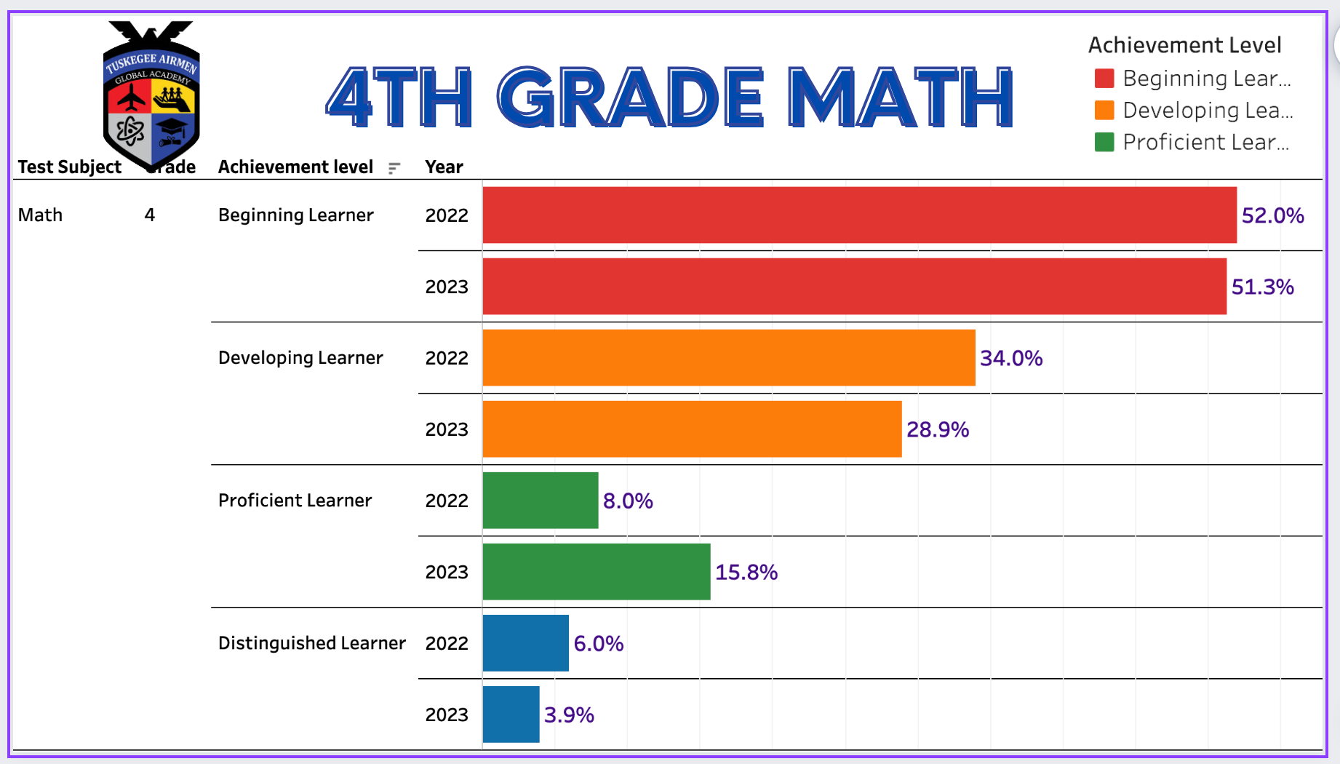
TUSKEGEE AIRMEN GLOBAL ACADEMY
“CONTINUING A LEGACY OF EXCELLENCE”
GMAS Overview

Slide 16
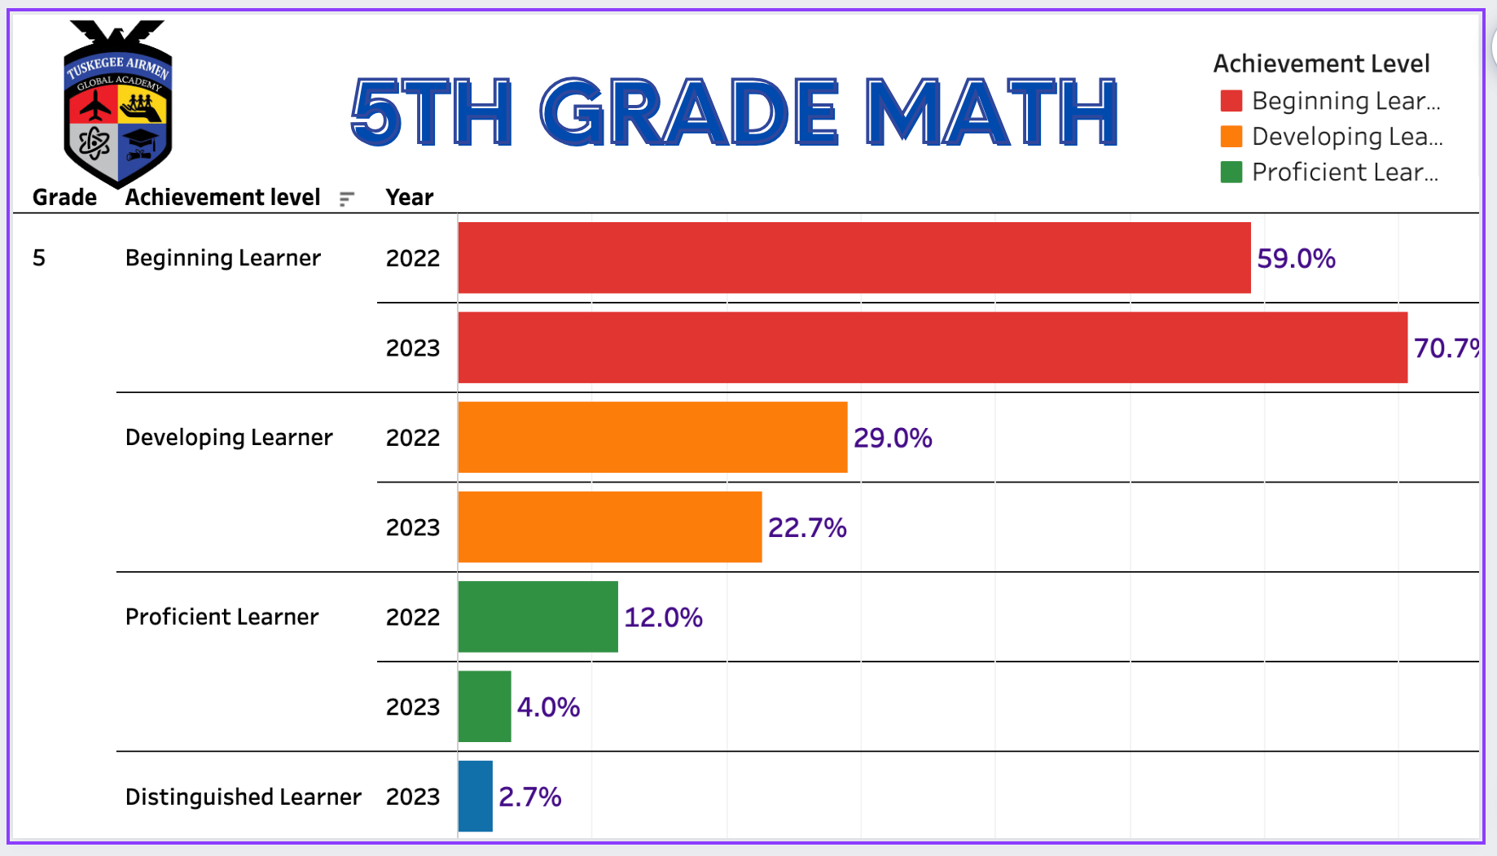
TUSKEGEE AIRMEN GLOBAL ACADEMY
“CONTINUING A LEGACY OF EXCELLENCE”
GMAS Overview

Slide 17
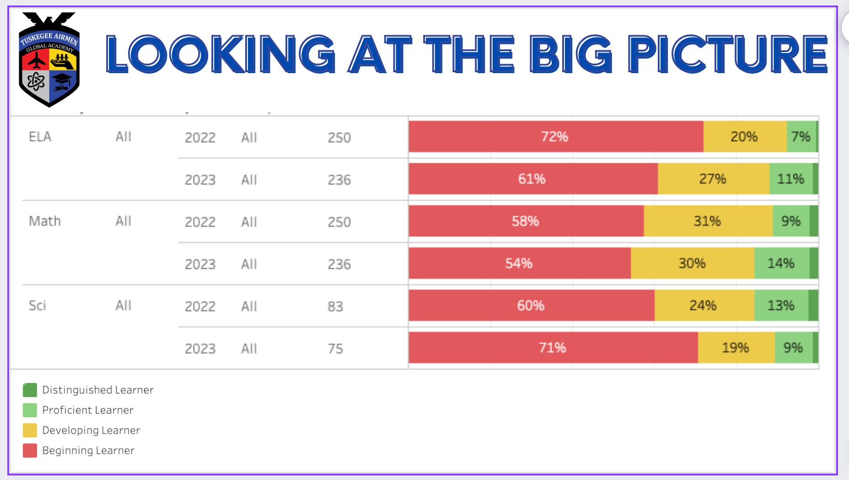

Slide 18


TUSKEGEE AIRMEN GLOBAL ACADEMY
“CONTINUING A LEGACY OF EXCELLENCE”
MAP DATA

Slide 19
TUSKEGEE AIRMEN GLOBAL ACADEMY
“CONTINUING A LEGACY OF EXCELLENCE”
MAP Data
OVERVIEW : ELA AND MATH COMBINED
READING
MATH

Slide 20
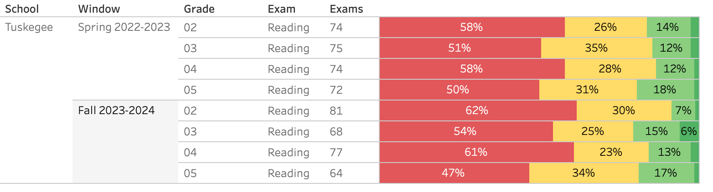
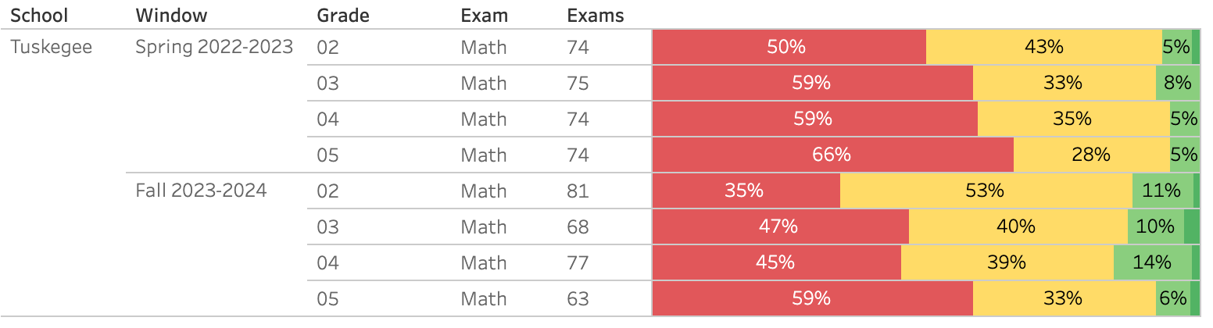
TUSKEGEE AIRMEN GLOBAL ACADEMY
“CONTINUING A LEGACY OF EXCELLENCE”
MAP Data
READING
MATH

Slide 21


TUSKEGEE AIRMEN GLOBAL ACADEMY
“CONTINUING A LEGACY OF EXCELLENCE”
What do you notice?
What are your wonderings?
What additional questions do you have?

Slide 22
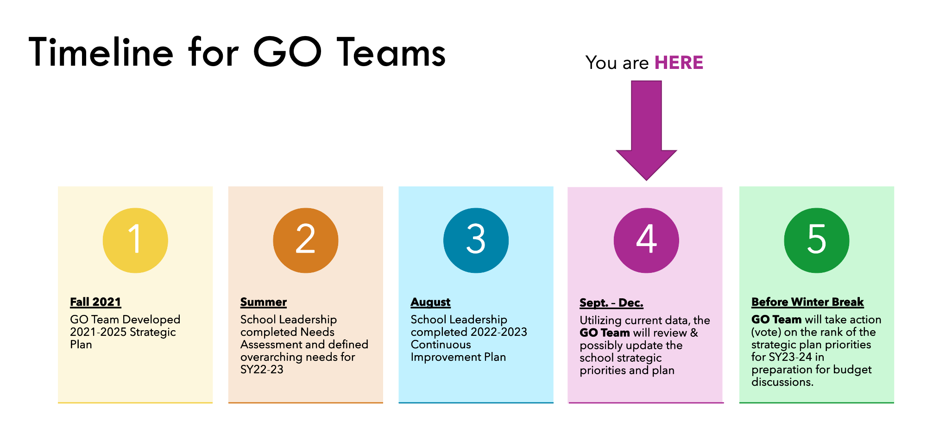
TUSKEGEE AIRMEN GLOBAL ACADEMY
“CONTINUING A LEGACY OF EXCELLENCE”
Timeline for GO Teams

Slide 23
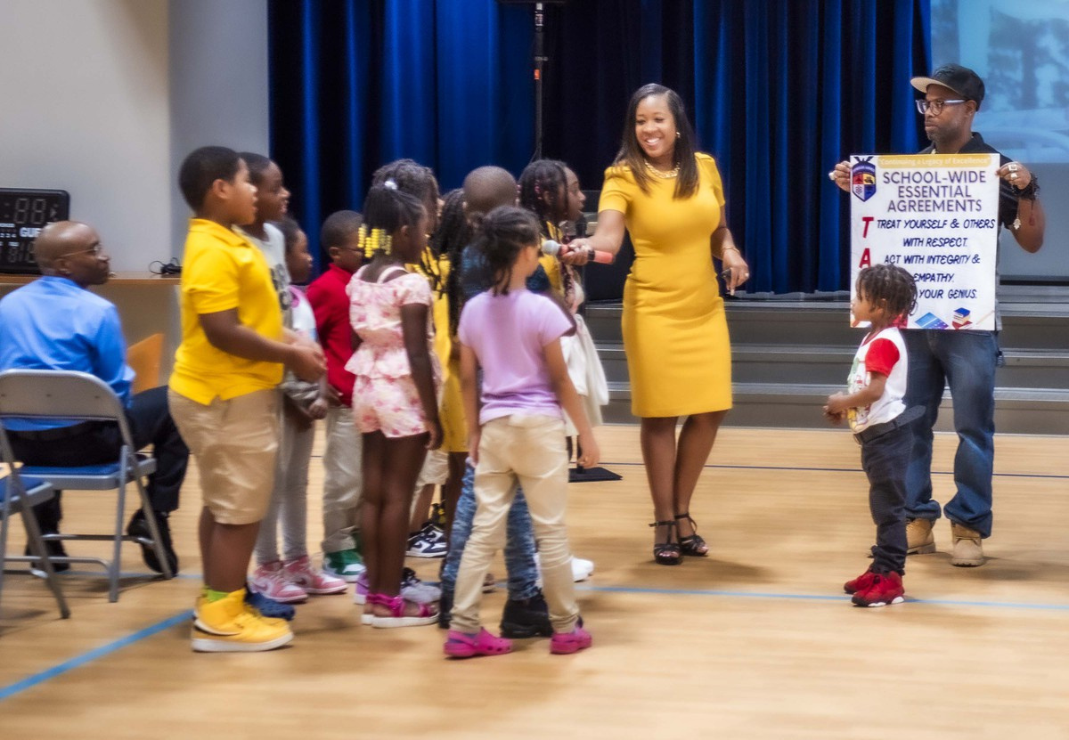


TUSKEGEE AIRMEN GLOBAL ACADEMY
“CONTINUING A LEGACY OF EXCELLENCE”
QUESTIONS?

Slide 24

TUSKEGEE AIRMEN GLOBAL ACADEMY
“CONTINUING A LEGACY OF EXCELLENCE”
PRINCIPAL'S REPORT
“Conituning a Legacy of Excellence”

Slide 25

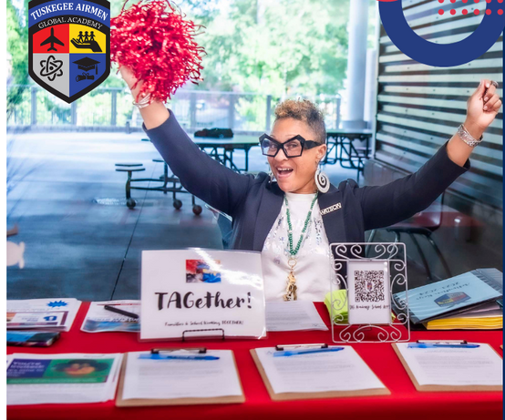
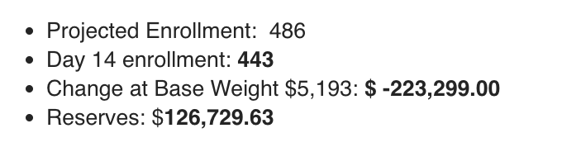
TUSKEGEE AIRMEN GLOBAL ACADEMY
“CONTINUING A LEGACY OF EXCELLENCE”
Beginning of the Year Data
Actual Enrollment
Projected Enrollment
PK- 19
K- 65
1- 86
2- 90
3- 69
4- 80
5- 65
Total: 474
Funding: 455
PK- N/A
K- 73 -8
1- 91 -5
2- 86 +4
3- 76 -7
4- 85 -5
5- 75 -10
Total: 486
Leveling

Slide 26
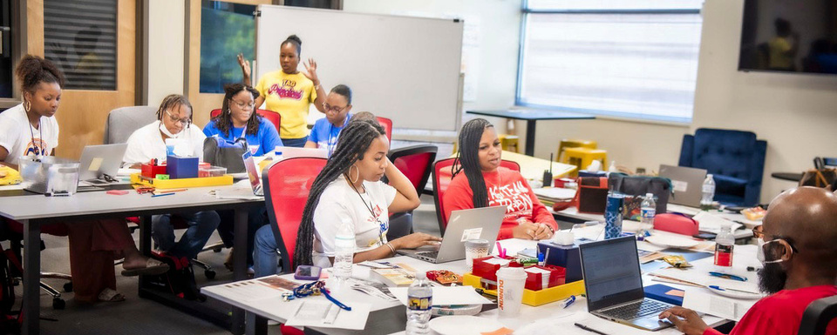
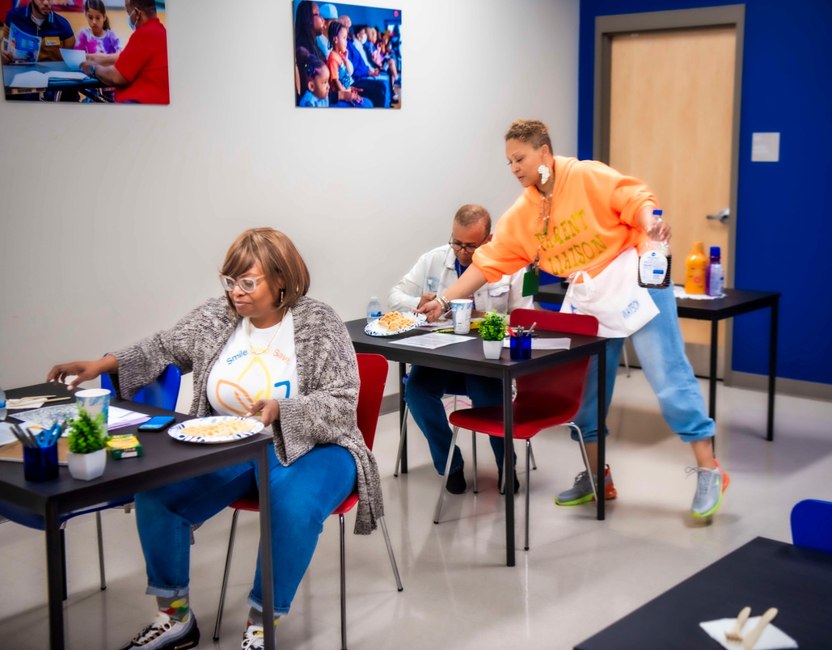

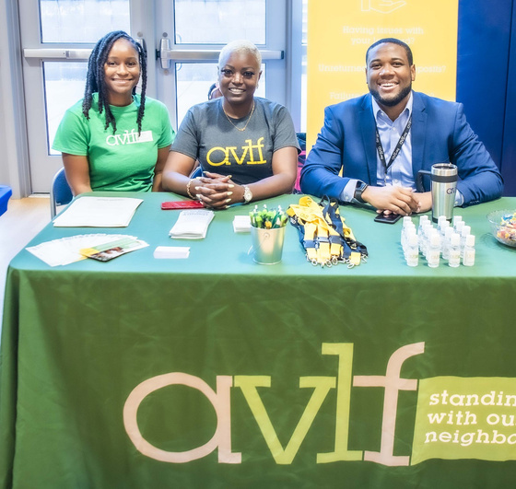
TUSKEGEE AIRMEN GLOBAL ACADEMY
“CONTINUING A LEGACY OF EXCELLENCE”
Things to Highlight
Academics
Family Engagement
Increased percentage of proficient and distinguished students in 3 out of 5 grade-levels in reading from Spring 23 to Fall 23
Increased percentage of proficient and distinguished students in every grade-level in math from Spring 23 to Fall 23
Our first academic family engagement event of the year was a huge success. We increased our parent engagement by over 100% from participation from last year! We are excited and gearing up for our next family engagement event STEM-ober on October 27! See you there.
Partners- AVLF
Westview Community Organization- Westview Winddown Wed./ Genuine Parts Company.
In house full- time housing support for families in need of lawyer services for adequate housing needs.
Donated over $300 dollars towards the purchase of new uniforms for students in need.
Donation of gently used uniforms for students in need.

Slide 27


Slide 28

TUSKEGEE AIRMEN GLOBAL ACADEMY
“CONTINUING A LEGACY OF EXCELLENCE”
PUBLIC
COMMENT

